Slide 1
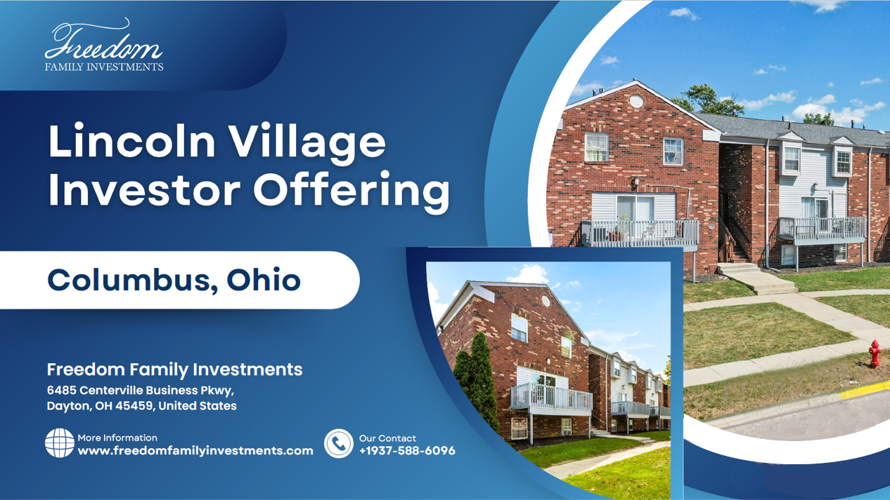

Slide 2
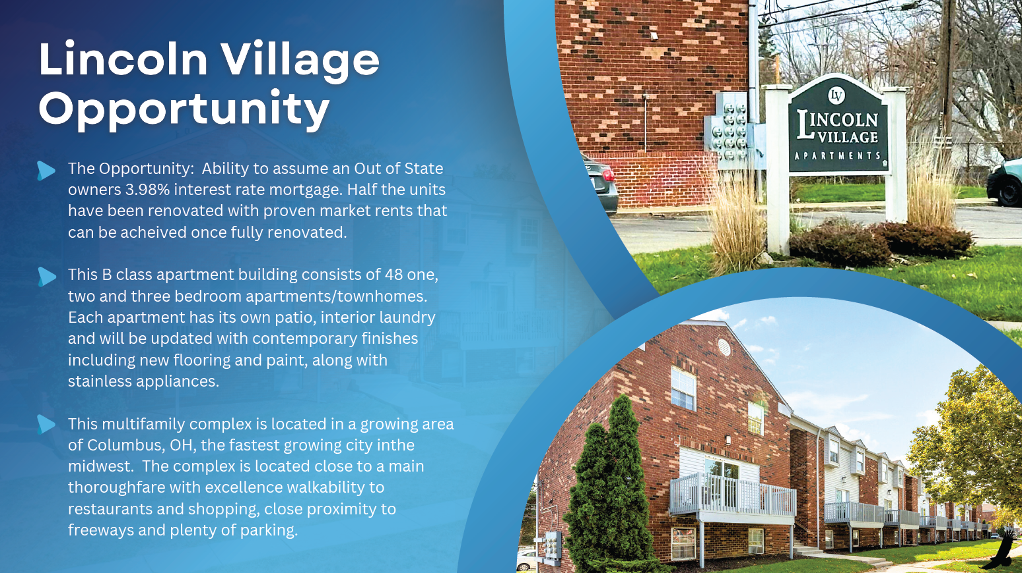

Slide 3
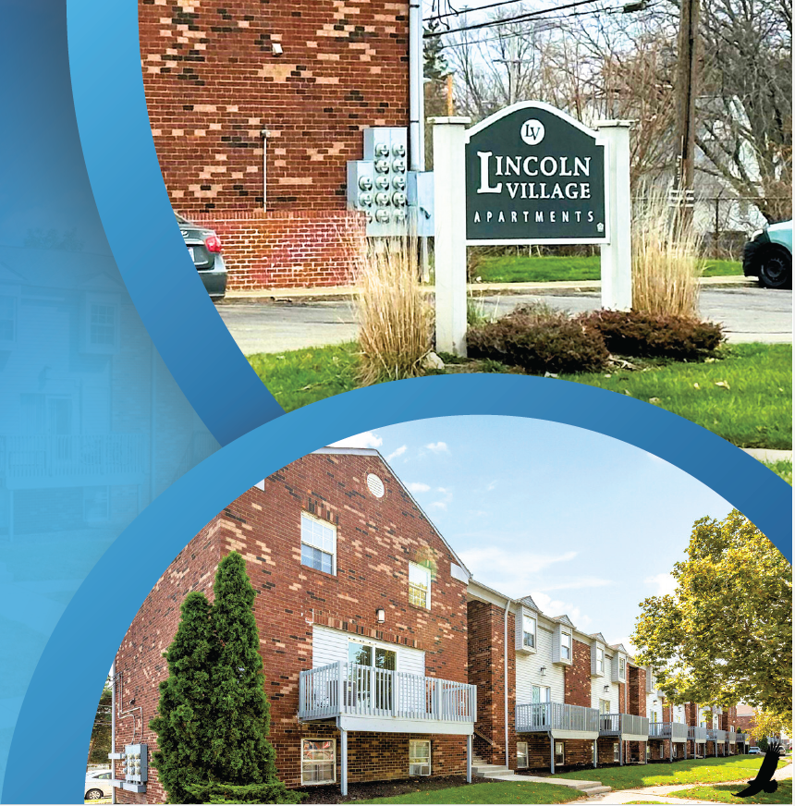
The Opportunity: Ability to assume an Out of State
owners 3.98% interest rate mortgage. Half the units
have been renovated with proven market rents that
can be achived once fully renovated.
This B class apartment building consists of 48 one,
two and three bedroom apartments/townhomes.
Each apartment has its own patio, interior laundry
and will be updated with contemporary finishes
including new flooring and paint, along with
stainless appliances.
This multifamily complex is located in a growing area
of Columbus, OH, the fastest growing city inthe
midwest. The complex is located close to a main
thoroughfare with excellence walkability to
restaurants and shopping, close proximity to
freeways and plenty of parking.

Slide 4
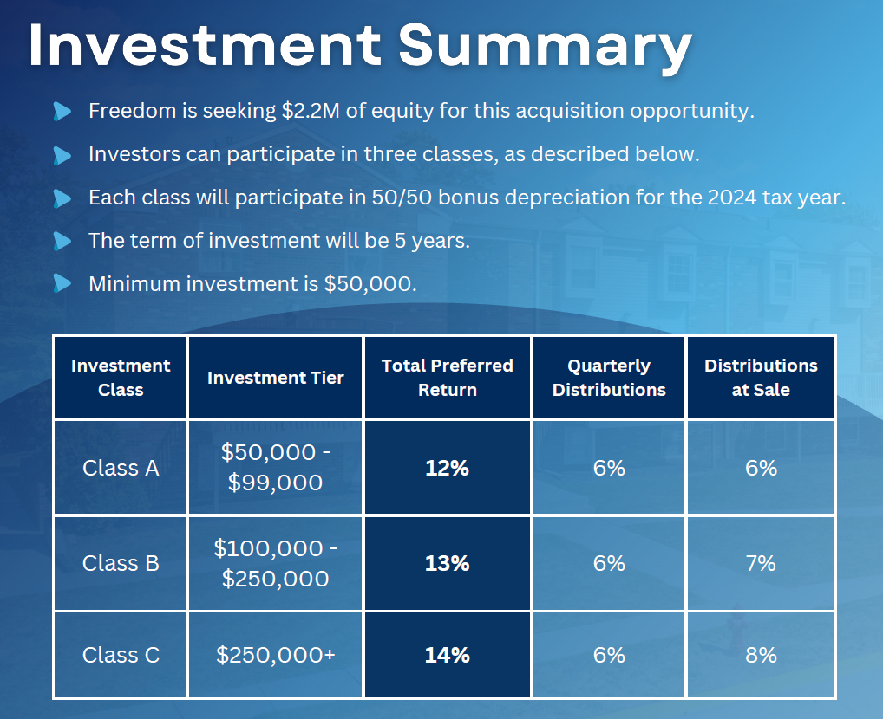

Slide 5
Investment Summary
Freedom is seeking $2.2M of equity for this acquisition opportunity.
Investors can participate in three classes, as described below.
Each class will participate in 50/50 bonus depreciation for the 2024 tax year.
The term of investment will be 5 years.
Minimum investment is $50,000.

Slide 6
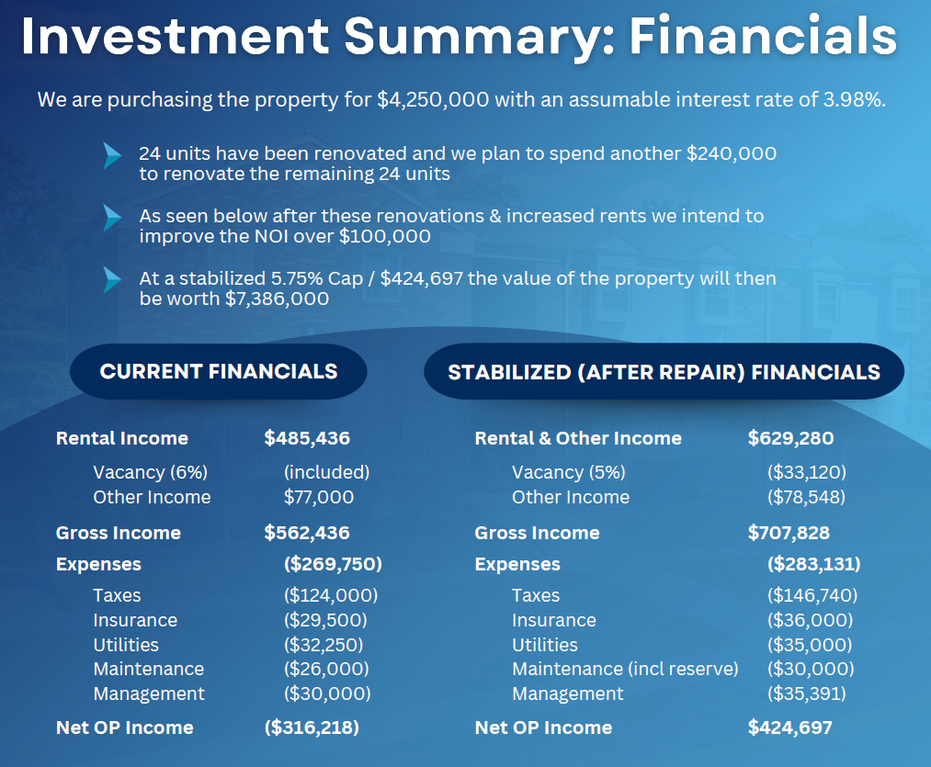

Slide 7
Business Plan
Renovate Units
We anticipate nearly $240,000 of improvements to the building and renovating the remaining 24 units to achieve a higher rent for the building
The unit renovations will consist of new flooring, paint, kitchen cabinets/countertops, & modernizing the bathrooms
Operate Efficiently
The previous owner was an out of state landlord that could not effectively manage the property & property manager
Bring on our 3rd party property manager that manages similar assets in Ohio for us. Our home office is less than an hour away so we will be able to check in regularly throughout the lifecycle of managing the asset
Increase the NOI
Through the renovations we will look to see an increase of 30% in current rent roll
Having an in-house renovations company we will be able decrease material and labor costs for renovations

Slide 8
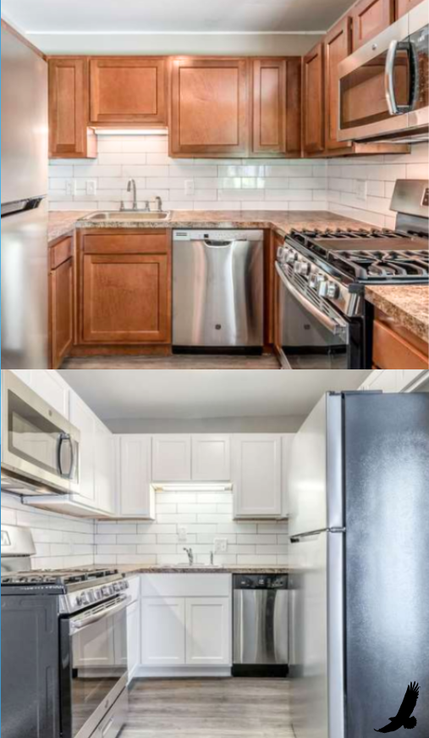
Exterior Photos

Slide 9
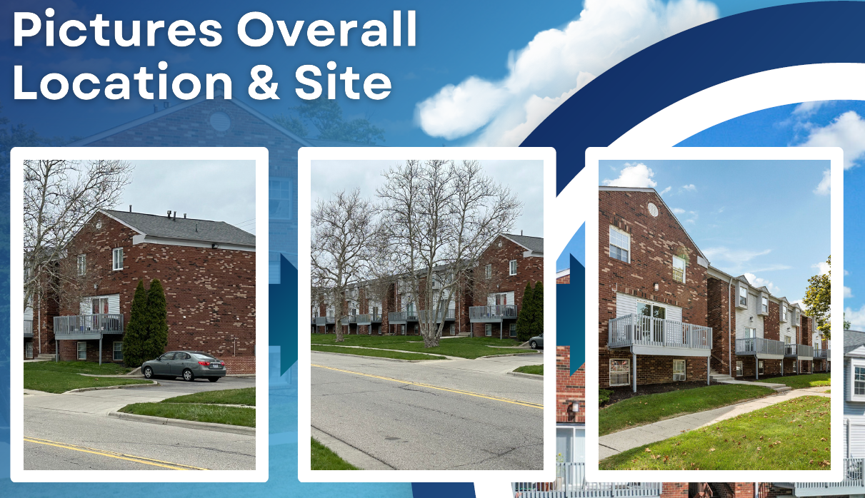

Slide 10
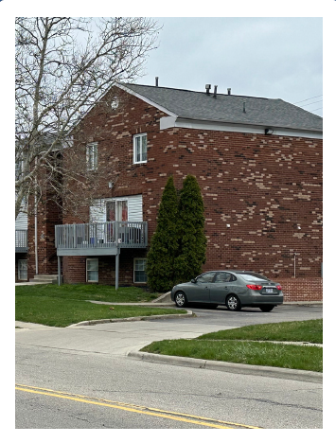
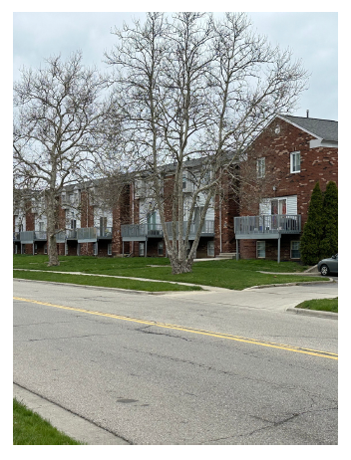
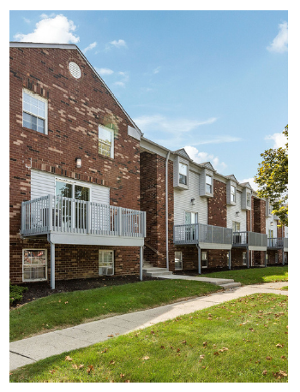
Exterior Photos

Slide 11
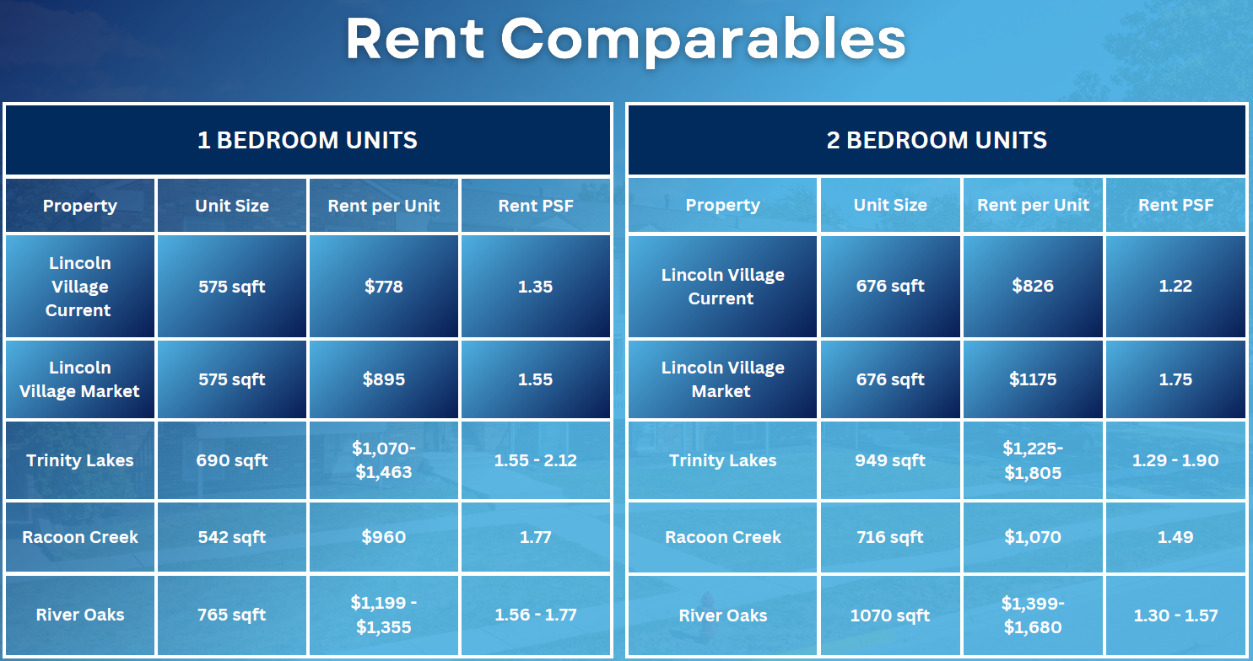

Slide 13
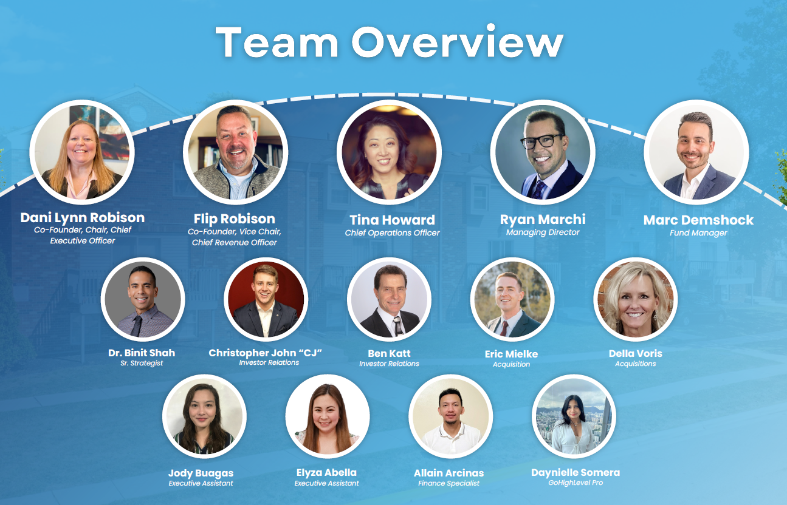

Slide 15


